Slide 1
Poetry

Slide 2

Haiku Poem
1. Follows Form: 5 points
Line 1 --5 syllables
Line 2—7 syllables
Line 3—5 syllables
2. Addresses setting: 5 points
A traditional Japanese haiku is a three-line poem with seventeen syllables, written in a 5/7/5 syllable count. The first line will have 5 syllables, the second line will have 7, and the third line will have 5.
They are often about nature.
Example:
Hogwarts is magic.
Professors, creatures, and friends.
I really love it.

Slide 3
Limerick Poem
1. Follows Form: 5 points
-5 lines, Long, long, short, short, long
Rhyme scheme: aabba
2. Describes character physically: 5 points
3. Describes character behavior: 5 points
A limerick is a form of verse, usually humorous, in five-line with a strict rhyme scheme of AABBA, in which the first, second and fifth lines rhyme, while the third and fourth lines are shorter and share a different rhyme.
(The meter is anapestic, which means every third syllable is stressed. Just try to match the rhythm of the example.) Can't hear it? Here are more examples.
Example:
Harry Potter, the lightning-scarred boy,
Went to Hogwarts, and there he found joy.
He made enemies and friends
And with Snape made amends,
Though he never did like the Malfoys!

Slide 4
Acrostic Poem
1. Min 70 words: 5 points
2. Follows form: Acrostic spells a word down the side from the novel: 10 points
3. Includes major plot points, including climax: 10 points
An acrostic poem is a poem where certain letters in each line spell out a word or phrase. Typically, the first letters of each line are used to spell the message, but they can appear anywhere.
Example:
H-arry Potter was a special wizard,
A-lways worried about his friends
R-on met Harry at Hogwarts School
R-iding broomsticks was so cool
Y-ule Ball was like their senior prom
P-eople tried to kill him
O-thers would try to protect
T-ogether they went to defeat Voldemort
T-he battle ensued
E-veryone banded together
R-elief, after sweet victory

Slide 5
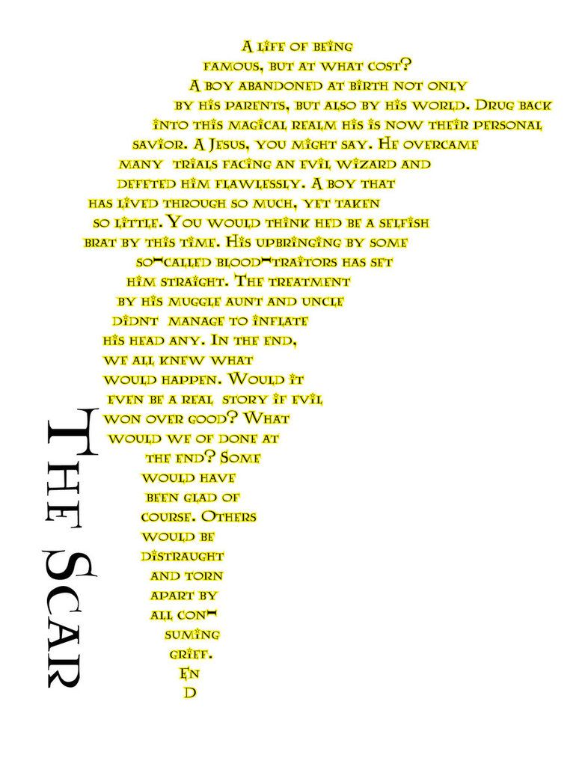
Concrete Poem
1. Min 70 words: 5 points
2. Follows form: Concrete is in the shape of something from the novel: 10 points
3. Includes major plot points, including climax: 10 points
Concrete poetry—sometimes also called ‘shape poetry’—is poetry whose visual appearance matches the topic of the poem. The words form shapes which illustrate the poem’s subject as a picture, as well as through their literal meaning.
Example:

Slide 6
Cinquain Poem
1. Follows form: 15 points
5 lines
Line 1: 2 syllables
Line 2: 4 syllables
Line 3: 6 syllables
Line 4: 8 syllables
Line 5: 2 syllables
Cinquains are five lines long. They have 2 syllables in the first line, 4 in the second, 6 in the third, 8 in the fourth line, and just 2 in the last line. Cinquains do not need to rhyme, but you can include rhymes if you want to.
Example:
Hello.
I miss you all.
Teaching you was awesome.
School is not the same anymore.
So hard.
A poem by Mrs. Hernandez to her students.

Slide 7
Villanelle
1. Follows Form: 15 points
-19 lines, 10 syllables each
Rhyme scheme:
aba aba aba aba
aba aba
2. Repeats two refrains supporting theme: 20 points
Here's a video about them.
Do Not Go Gentle into That Good Night by Dylan Thomas
Do not go gentle into that good night,
Old age should burn and rave at close of day;
Rage, rage against the dying of the light.
Though wise men at their end know dark is right,
Because their words had forked no lightning they
Do not go gentle into that good night.
Good men, the last wave by, crying how bright
Their frail deeds might have danced in a green bay,
Rage, rage against the dying of the light.
Wild men who caught and sang the sun in flight,
And learn, too late, they grieved it on its way,
Do not go gentle into that good night.
Grave men, near death, who see with blinding sight
Blind eyes could blaze like meteors and be gay,
Rage, rage against the dying of the light.
And you, my father, there on the sad height,
Curse, bless, me now with your fierce tears, I pray.
Do not go gentle into that good night.
Rage, rage against the dying of the light.

Slide 8
More Limericks!
Listen for the meter.
The Tutor
by Carolyn Wells
The tutor who tooted the flute,
Tried to tutor two tooters to toot.
Said the two to the tutor:
"Is it harder to toot or
To tutor two tooters to toot?"
There Was an Old Man with a Beard
by Edward Lear
There was an Old Man with a beard,
Who said, "It is just as I feared!
Two Owls and a Hen,
Four Larks and a Wren,
Have all built their nests in my beard!”
Another Old Man?
There was an Old Man who supposed,
That the street door was partially closed;
But some very large rats,
Ate his coats and his hats,
While that futile old gentleman dozed.

